Slide 1

Using Copernicus Atmosphere Monitoring Services To Map Natural Areas At Risk Due To Poor Air Quality
COPERNICUS UPTAKE
PhD in Environmental and Infrastructure Engineering
PhD candidate: Andrea Piccoli - 948693
Supervisor/Tutor: Professor Giovanni Lonati

Slide 2

METHODS
Download CAMS ensemble model output concentrations for NO, NO2, SO2, O3
Compute AQ indicators Maps
Create AQ limits exceedance maps
Match exceedance areas and Corine Land Cover Map
Check NDVI for similar forest areas but differently subjected to air pollution

Slide 3





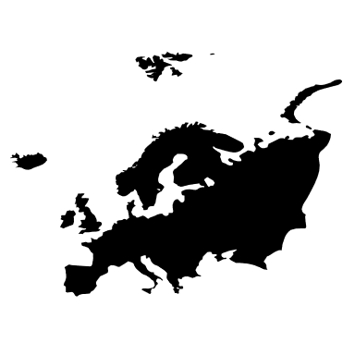

CAMS download and processing
CAMS API to download the model ensemble concentration (netCDF)
Climate Data Operators (CDO) to compute indicators
R for the conversion from netCDF to geoTiff
QGIS for mapping exceedance areas and QGIS+R to compute the total area at risk

Slide 4

UN and UE critical levels
Pollutant | Vegetation type | Critical level | UE | Time Period
O3 (AOT40) | All | 3000 [ppbV/h] | Long-term objective | May-July (5 year mean)
 | Horticultural crops | 8000 [ppbV/h] |  | May-July (5 year mean)
 | All (excl. forests) | 9000 [ppbV/h] | X | May-July (5 year mean)
 | Forests | 5000 [ppbV/h] | X | April-September
NOx | All | 30 [µg m⁻³] | X | Annual mean
SO₂ | Forest + (Semi-) natural Vegetation | 20 [µg m⁻³] | X (for all) | Half-year mean (October-March)
 | Agricultural crops | 30 [µg m⁻³] |  | Half-year mean (October-March)
Alonso, R.; et al. III. MAPPING CRITICAL LEVELS FOR VEGETATION; 2017.
EEA Air quality in Europe - 2020 report.

Slide 5
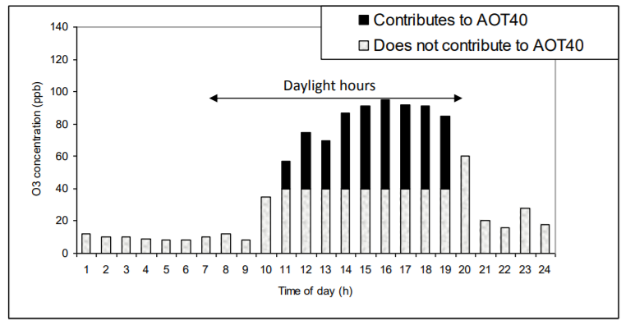
AOT40
Image from Alonso, R.; et al. III. MAPPING CRITICAL LEVELS FOR VEGETATION; 2017
Only day-time hours were downloaded from CAMS Atmosphere Data Store

Slide 6
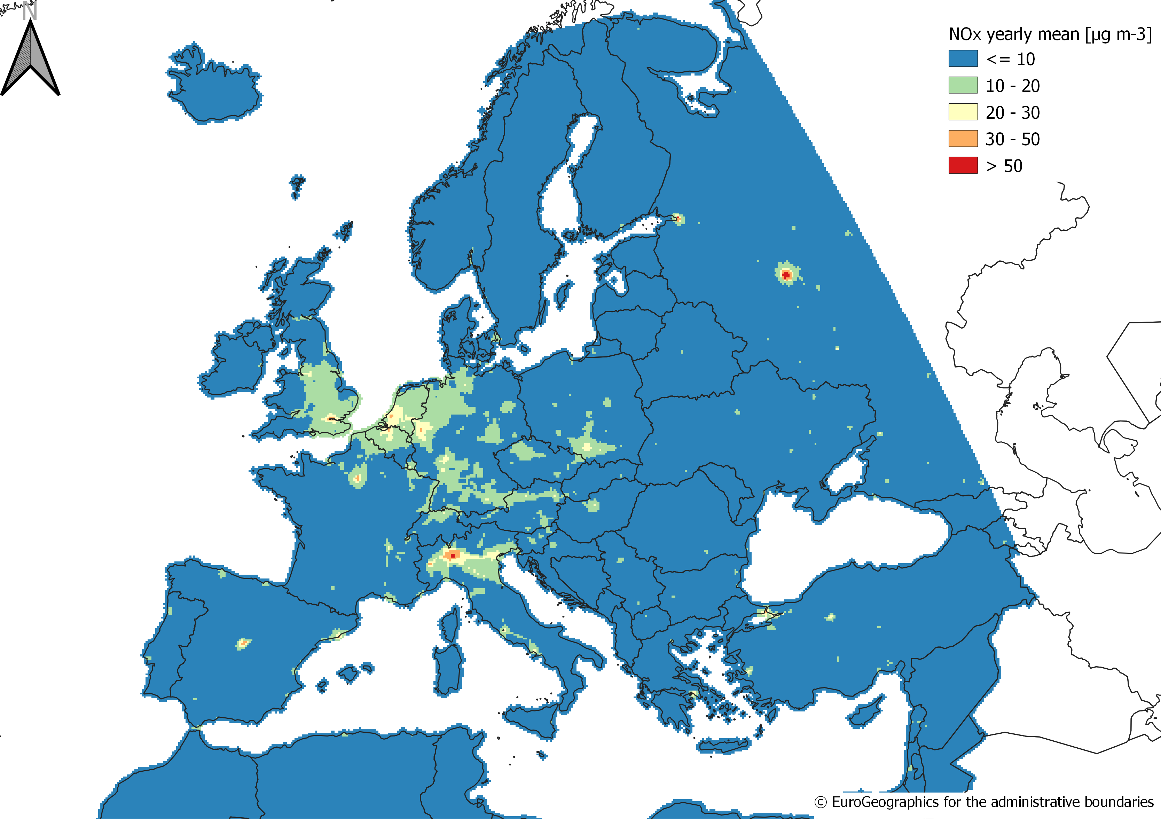
NO_{X}

Slide 7
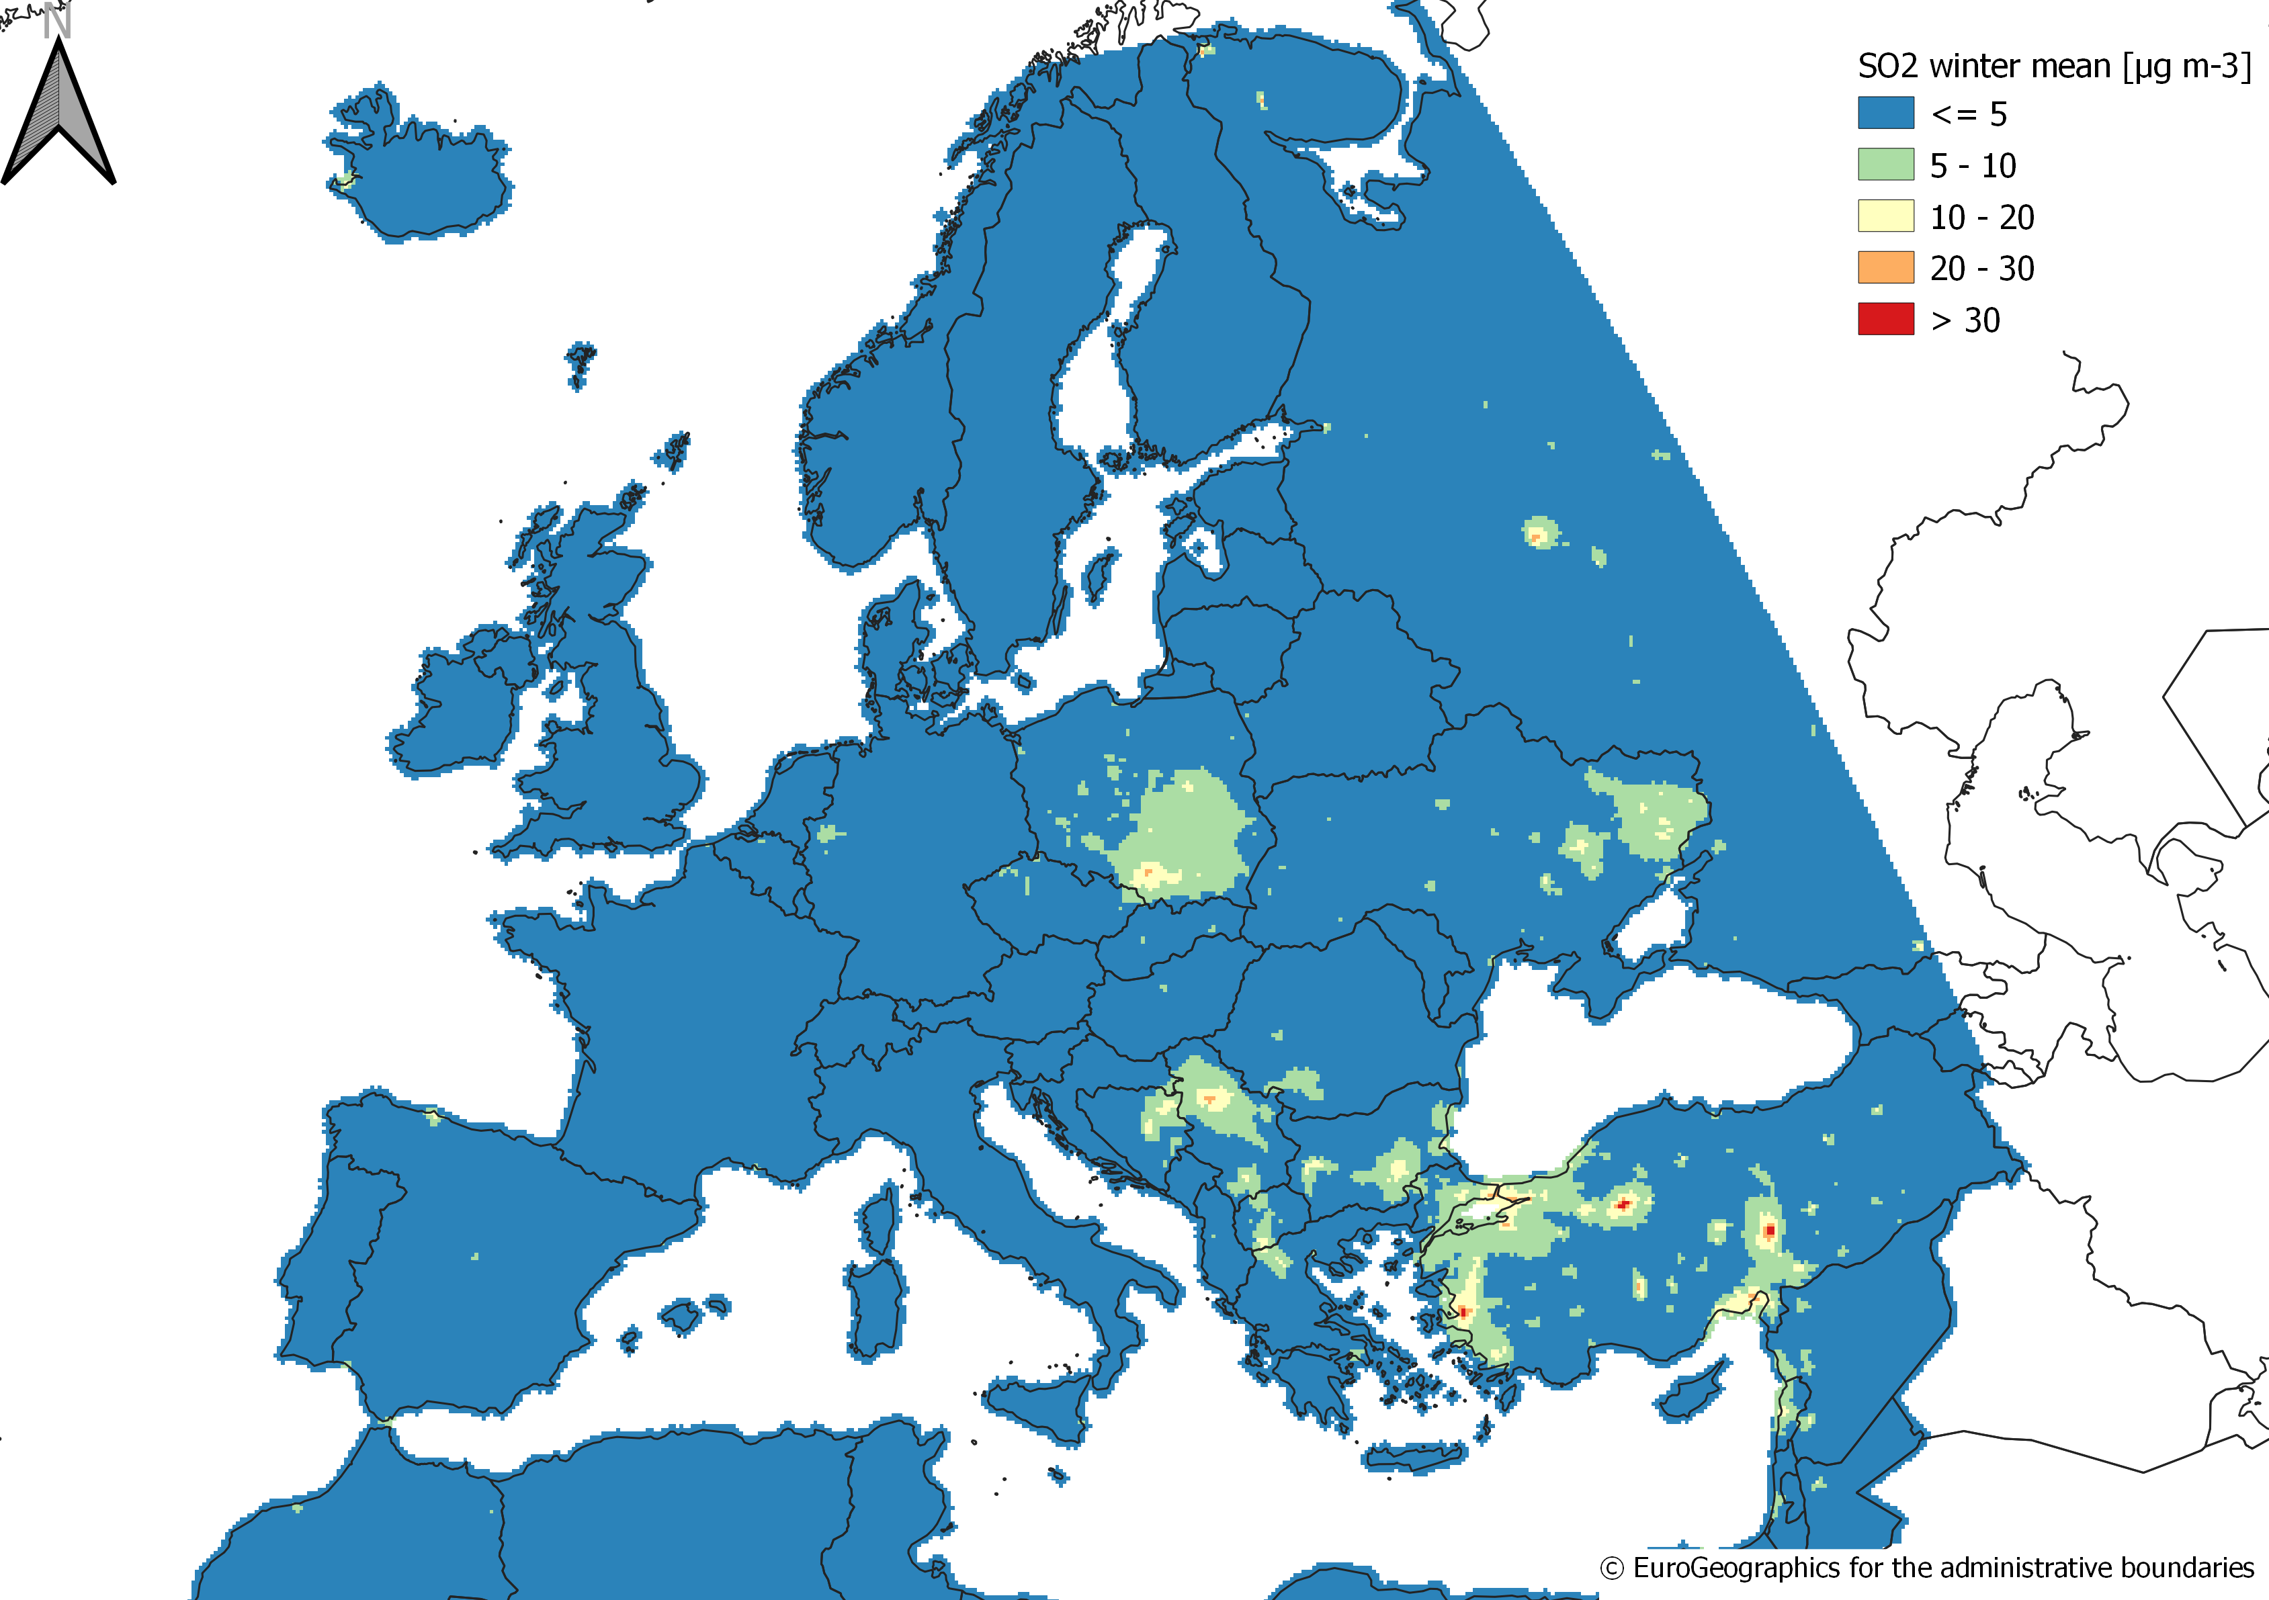
SO₂

Slide 8

STATS
VEGETATION TYPE | TOTAL AREA [km^2] | AREA > LIMIT [km^2] | % RISK AREA | % AREA CAMS DATA
AGRICOLTURE | 2320281.2 | 2499.2 | 0.11 | 99.86
FOREST | 1706371.4 | 299.9 | 0.02 | 99.74
HORTICOLTURE | 139856.7 | 0 | 0 | 99.71
VEGETATION | 1162140 | 0 | 0 | 98.06
ALL | 5328649.3 | 2799.1 | 0.05 | 99.42
NOx
VEGETATION TYPE | TOTAL AREA [km^2] | AREA > LIMIT [km^2] | % RISK AREA | % AREA CAMS DATA
AGRICOLTURE | 2320281.3 | 1799.4 | 0.08 | 99.86
FOREST | 1706371.4 | 299.9 | 0.02 | 99.74
HORTICOLTURE | 139856.7 | 0 | 0 | 99.71
VEGETATION | 1162140 | 899.7 | 0.08 | 98.06
ALL | 5328649.4 | 2999.1 | 0.06 | 99.42
SO₂

Slide 9

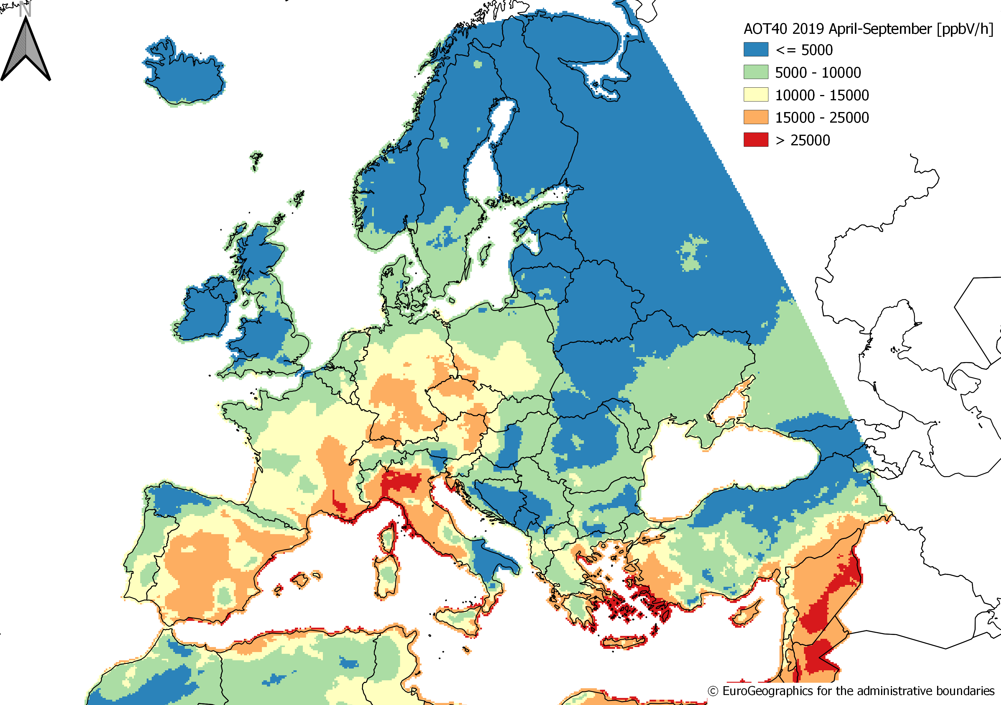
O3 Forests

Slide 10
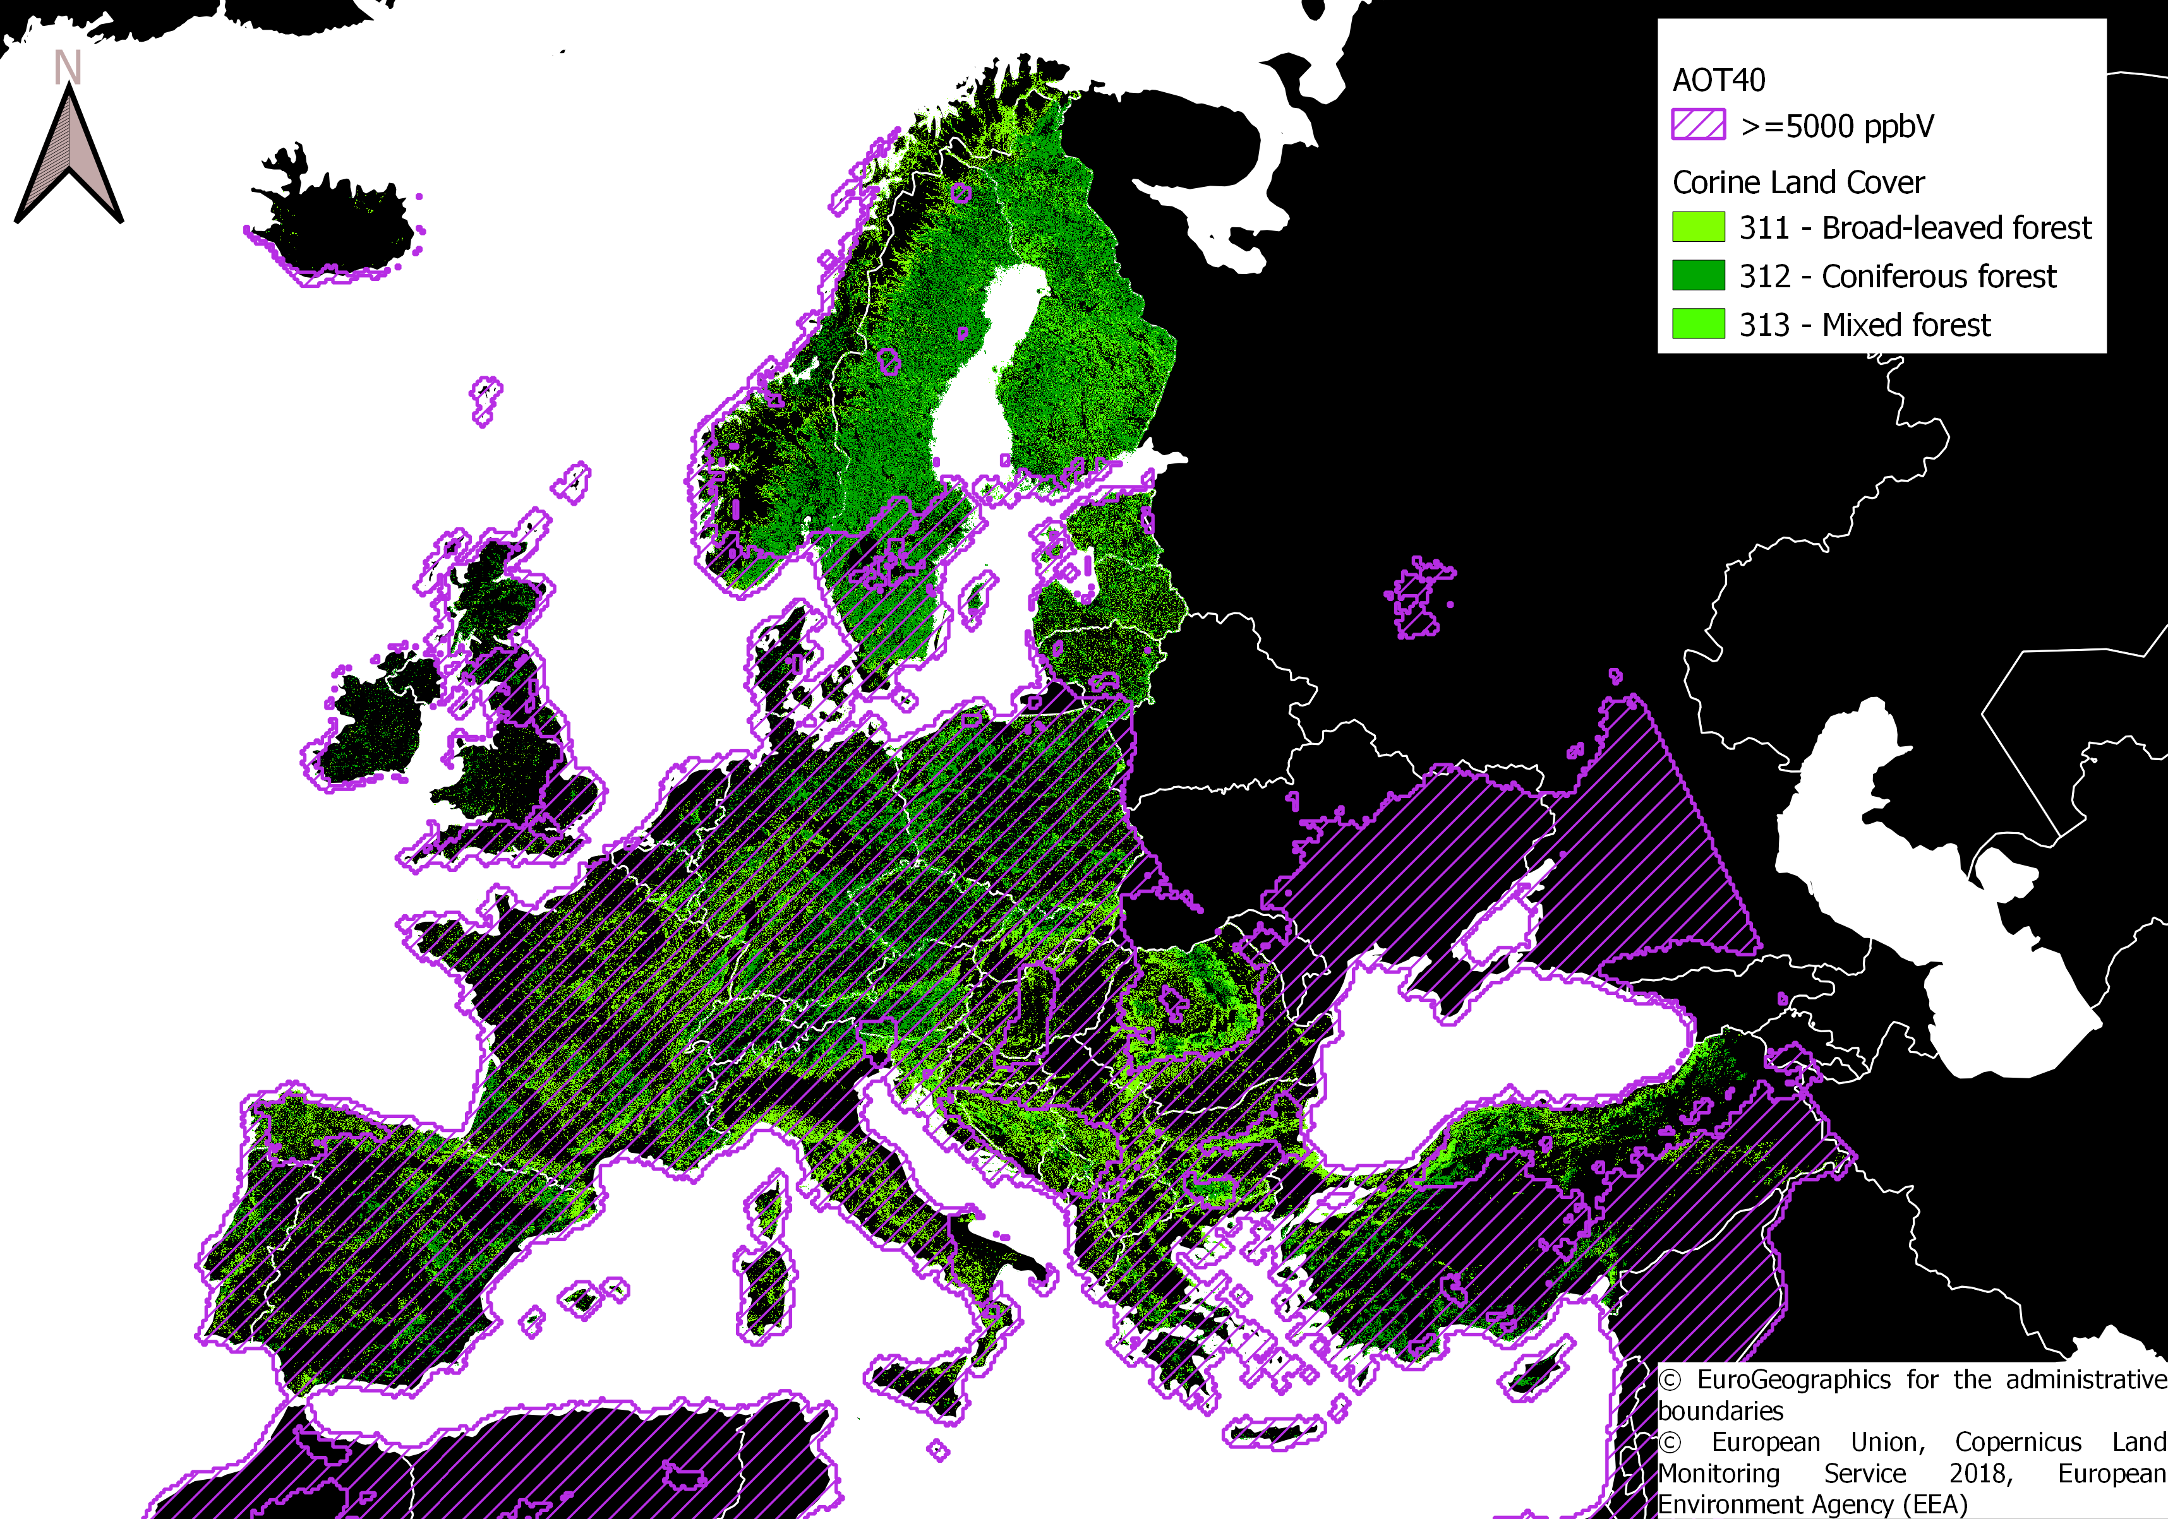
O3 Forests

Slide 11

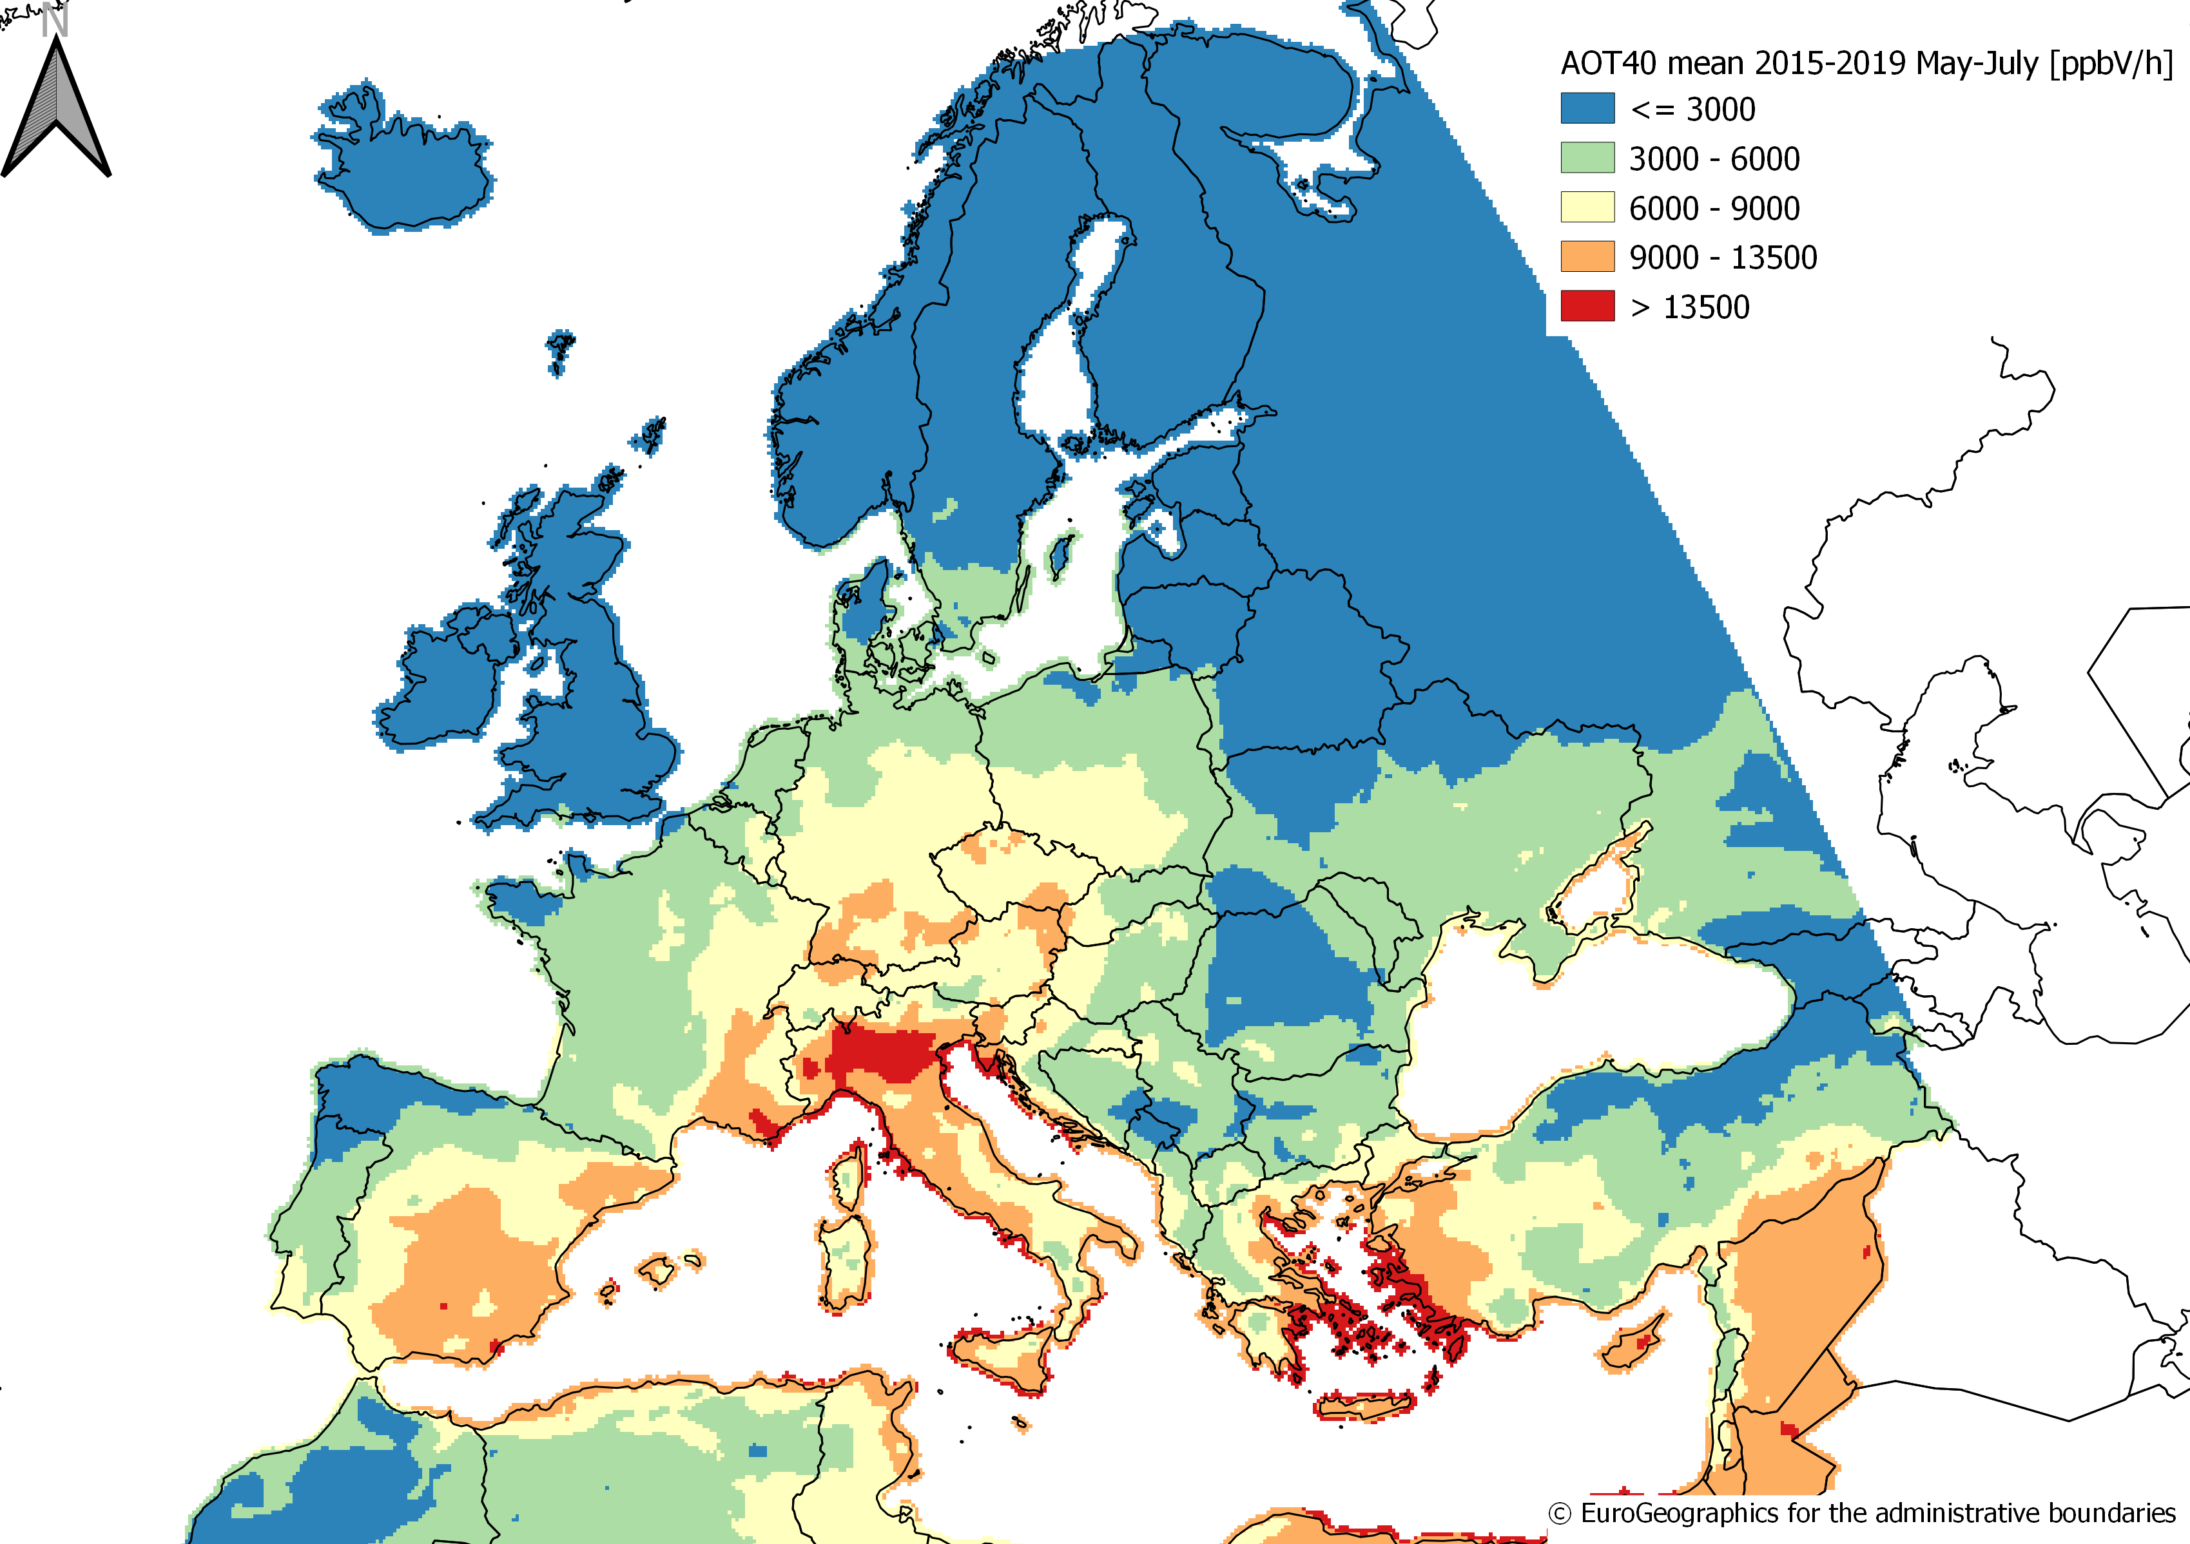
O3 Vegetation (excl. forests)

Slide 12

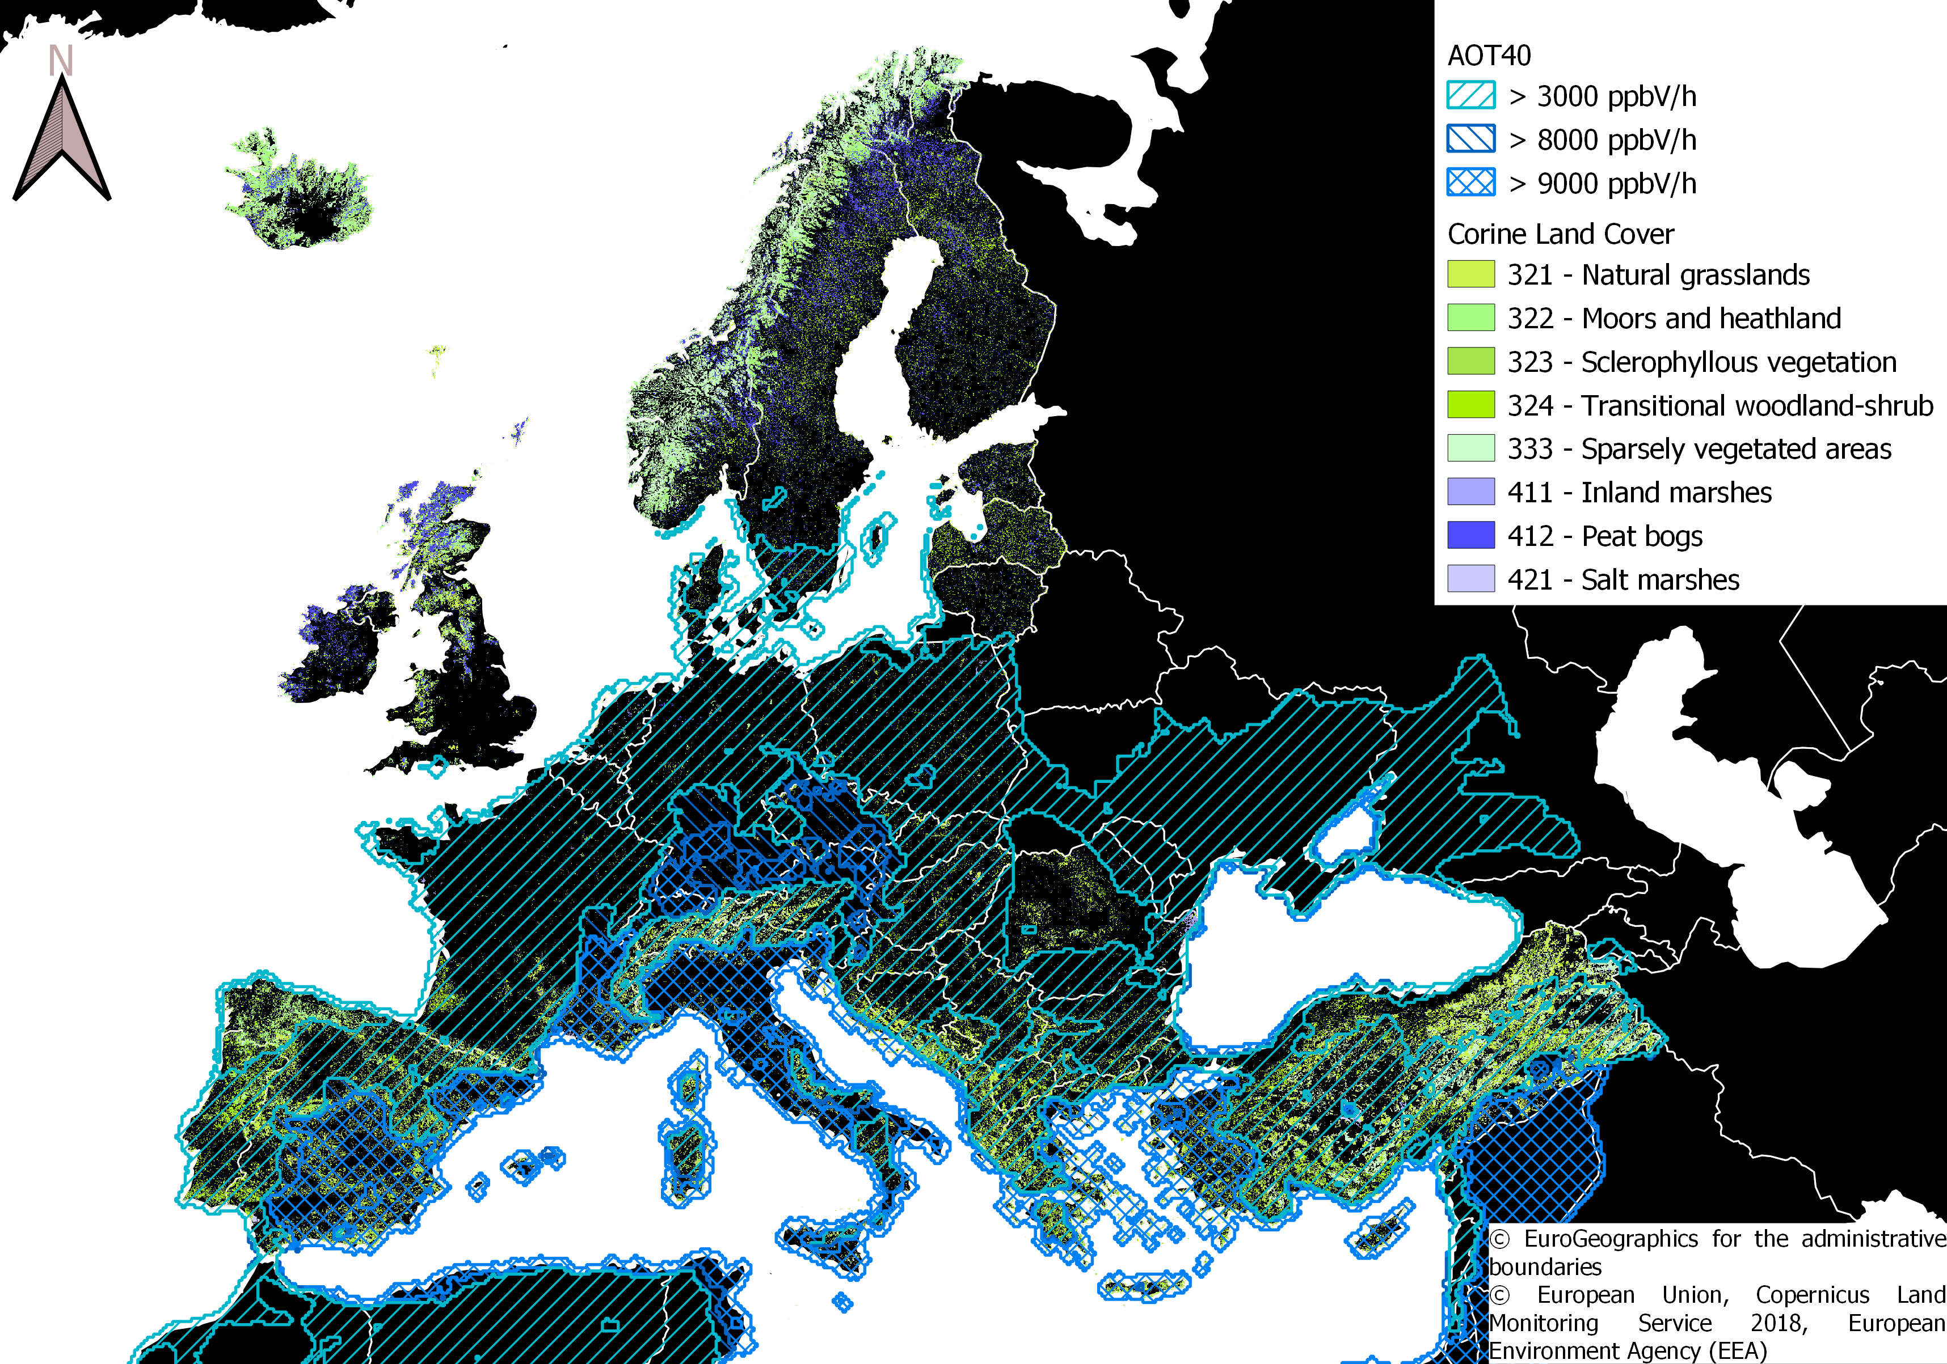
O3 (Semi-)natural vegetation

Slide 13
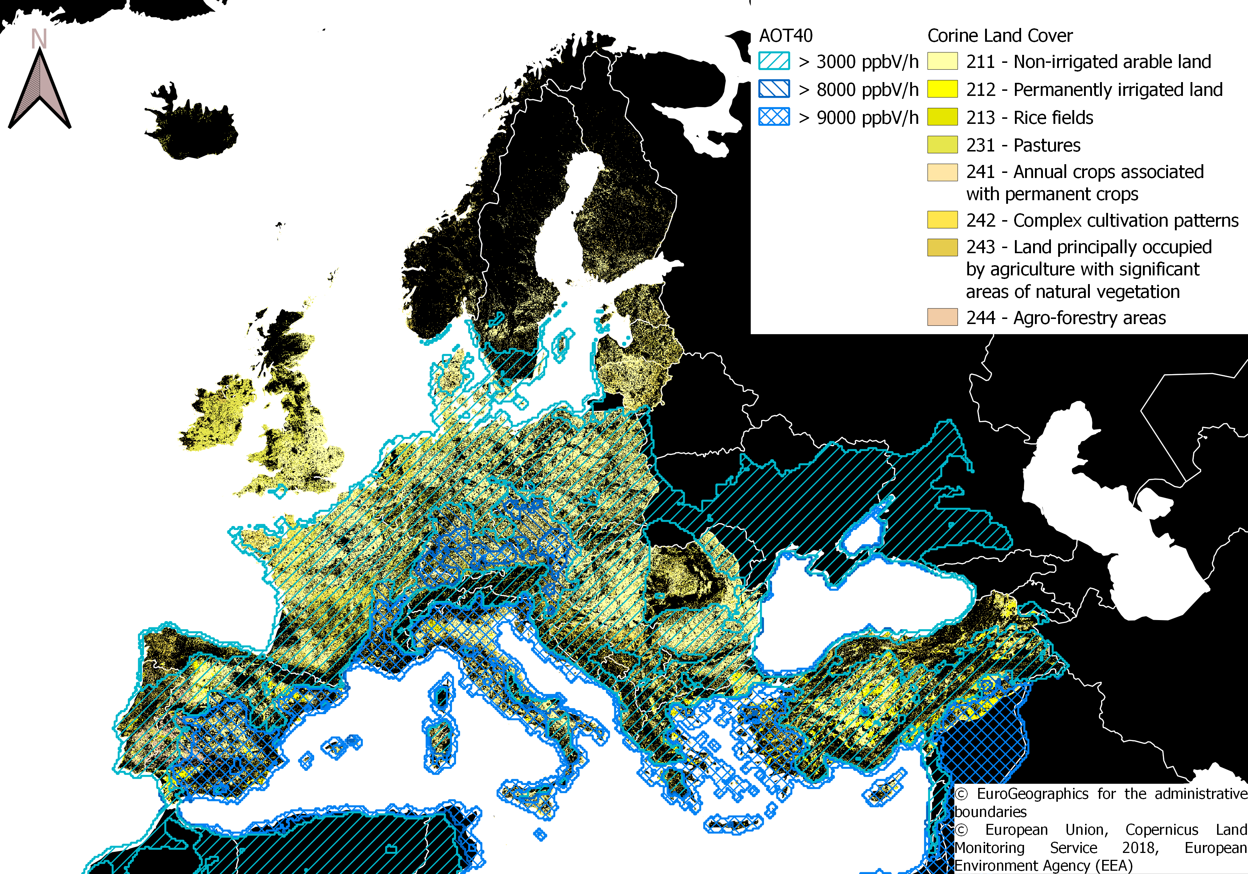
O3 Agricultural crops

Slide 14
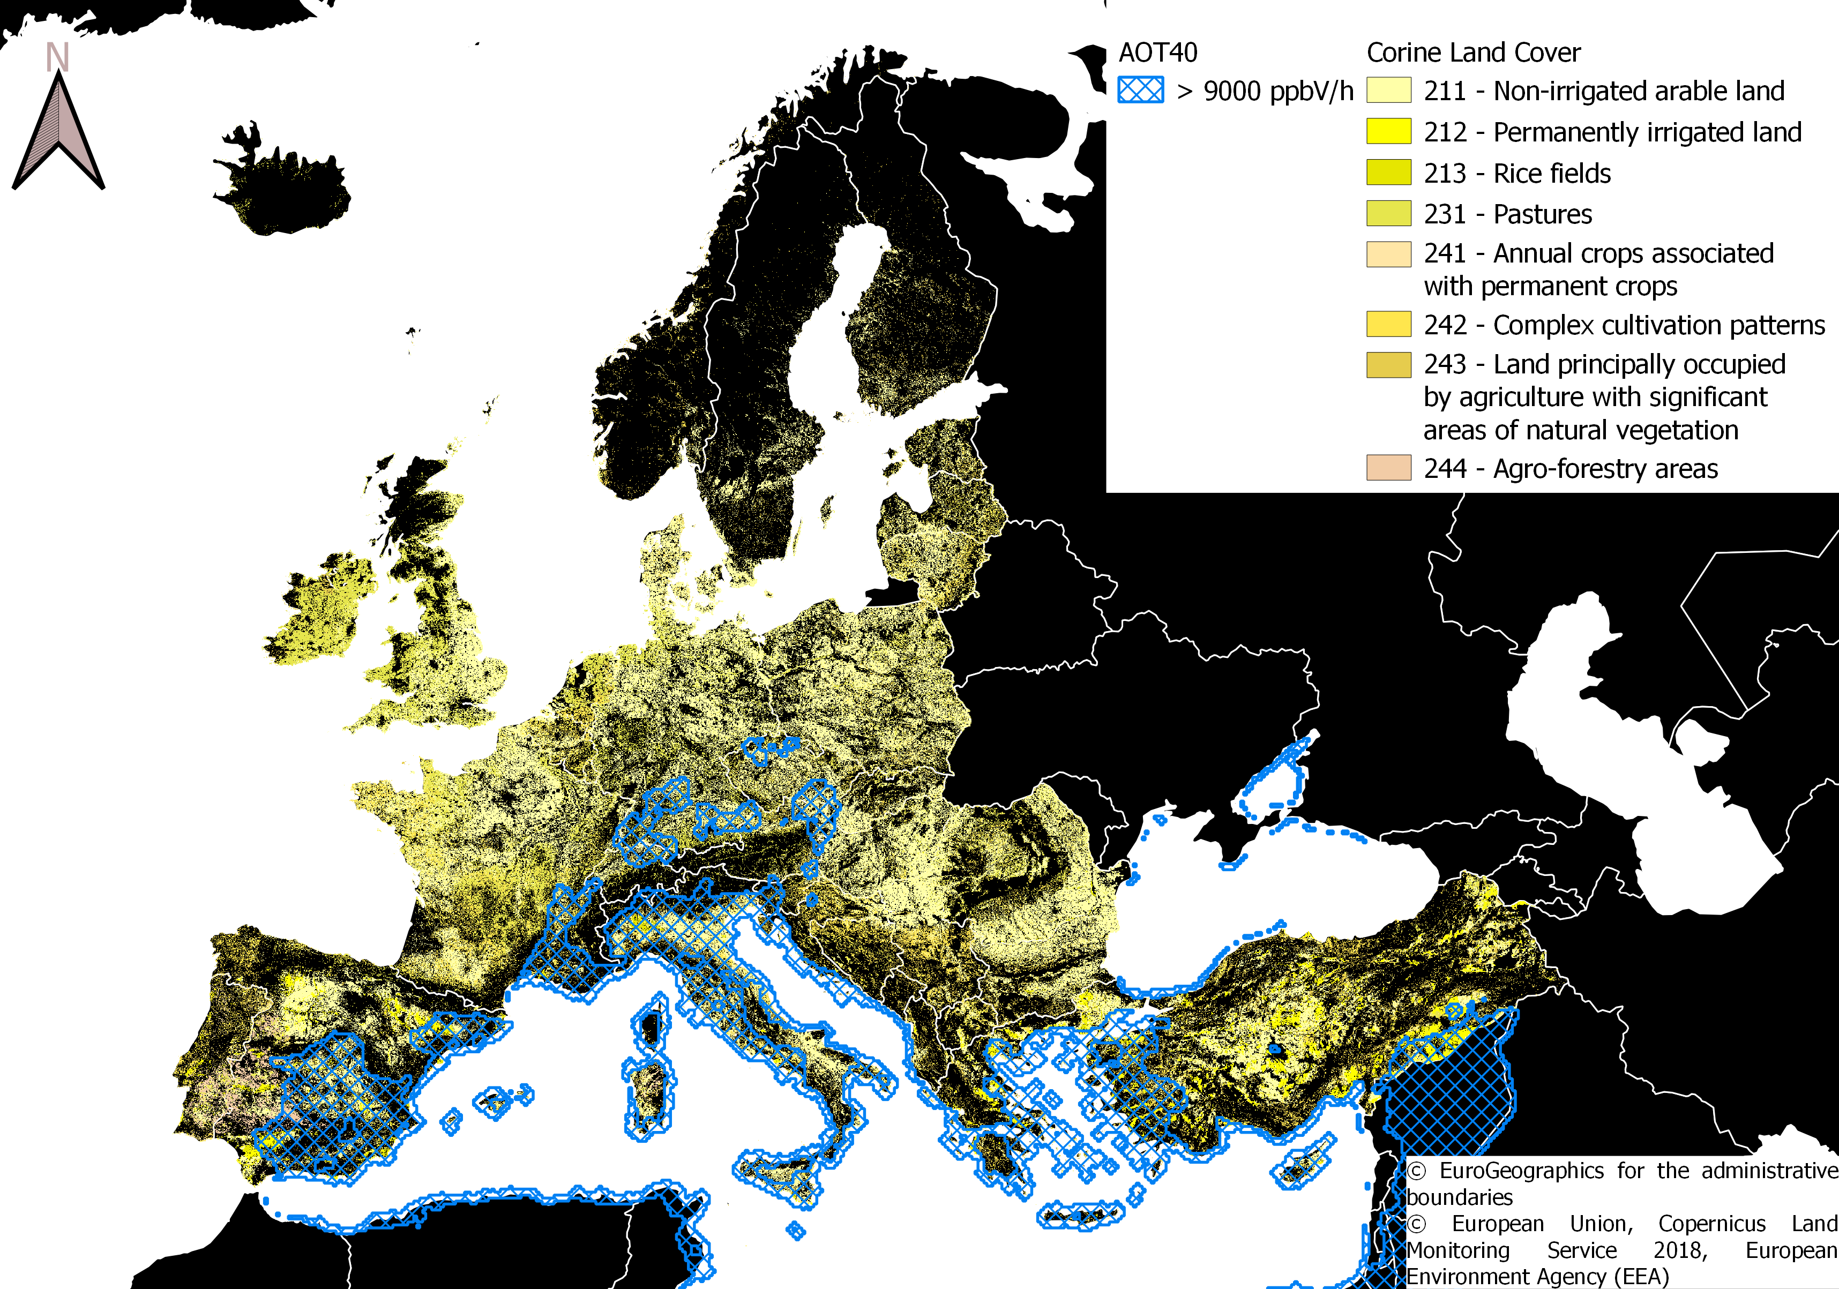
O3 Agricultural crops (UE limit)

Slide 15

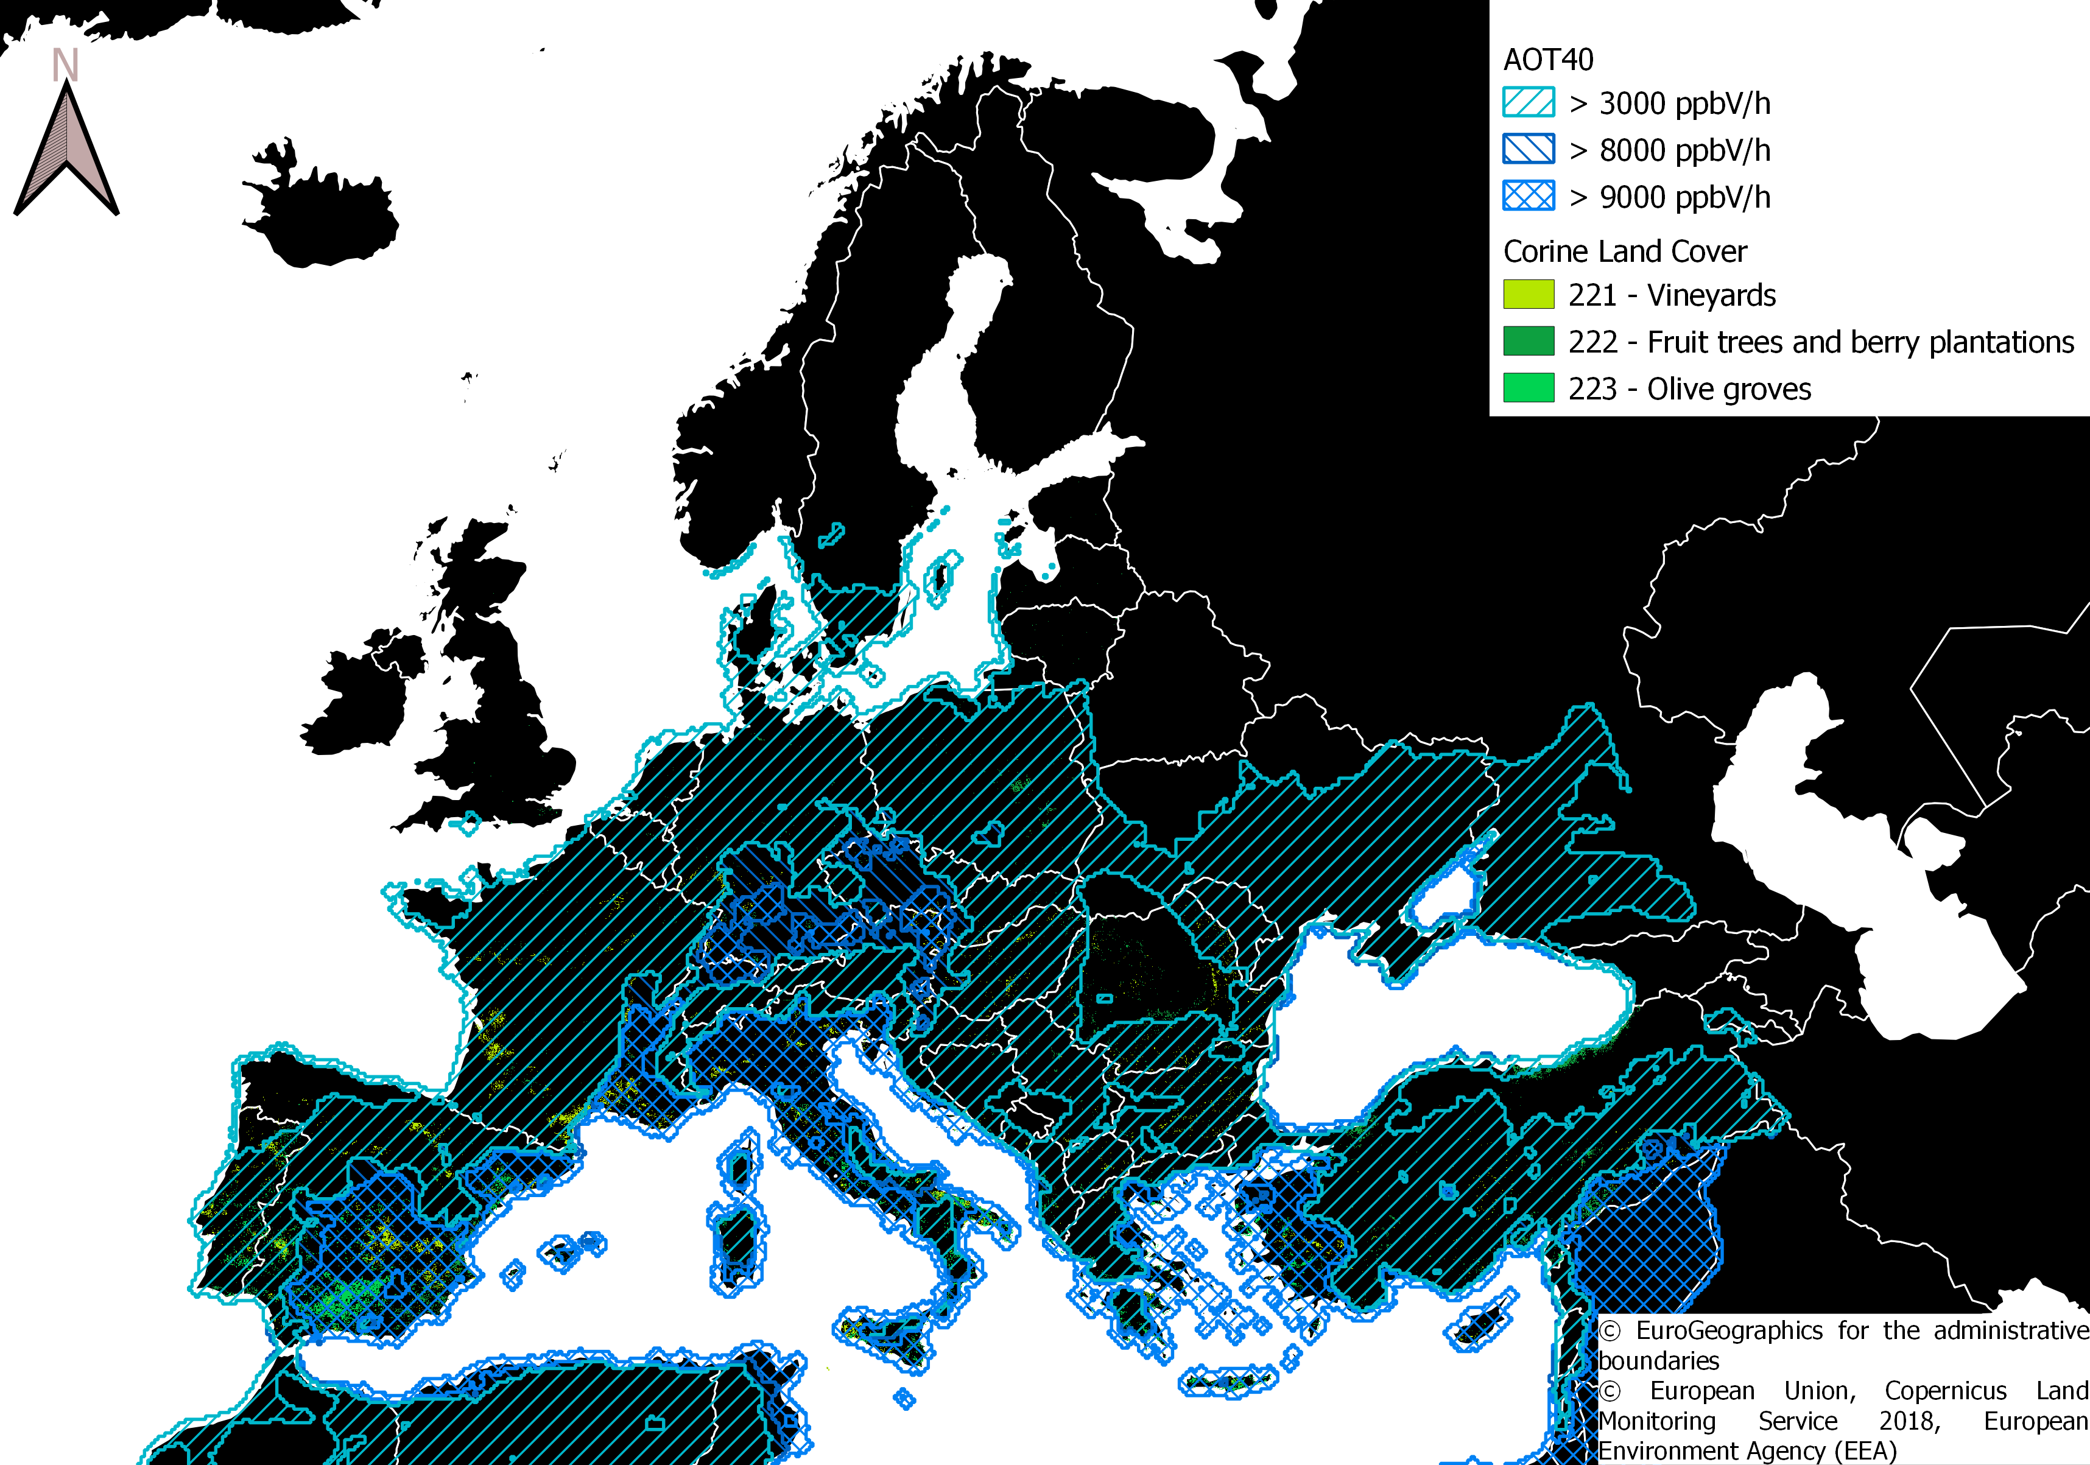
O3 Horticultural crops

Slide 16
STATS
FOREST TYPES | TOTAL AREA [km^2] | AREA > LIMIT [km^2] | % RISK AREA | % AREA CAMS DATA
BROAD-LEAVED | 586780 | 405690 | 69.14 | 99.43
CONIFEROUS | 817435.6 | 401732.2 | 49.15 | 99.87
MIXED | 310653.4 | 157425.8 | 50.68 | 99.95
ALL | 1714869 | 964847.9 | 56.26 | 99.73
VEGETATION TYPE | TOTAL AREA [km^2] | AREA > LT LIMIT [km^2] | AREA > UE LIMIT [km^2] | AREA > UN LIMIT [km^2] | % RISK AREA LT | % RISK AREA UE | % RISK AREA UN | % AREA CAMS DATA
AGRICOLTURE | 2320281 | 1817537 | 301606.6 | 473253.4 | 78.33 | 13 | 20.4 | 99.86
HORTICOLTURE | 139856.7 | 131859.2 | 72677.49 | 86173.31 | 94.28 | 51.97 | 61.62 | 99.71
VEGETATION | 1162140 | 583519.2 | 127160.6 | 178844.6 | 50.21 | 10.94 | 15.39 | 98.06
ALL | 3622278 | 2532915 | 501444.7 | 738271.3 | 69.93 | 13.84 | 20.38 | 99.27

Slide 17

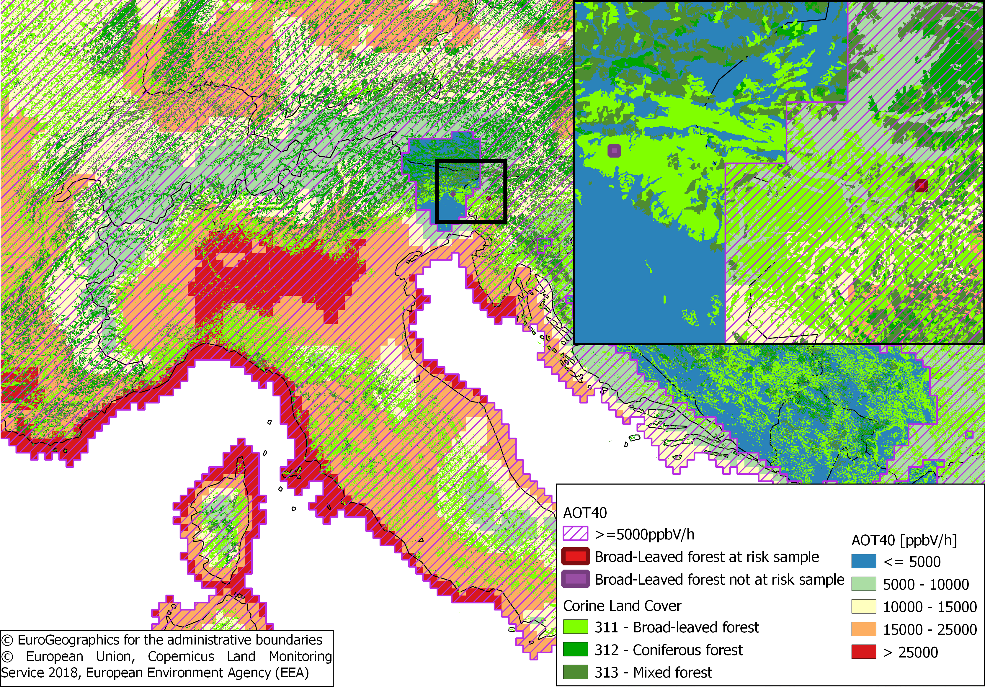
NDVI
Two 1.5x1.5km² sample area in broad-leaved forest, one exceeding the AOT40 limit (12431 ppb/h) and the other below the limit (2425 ppb/h)
Fagus (beech) is the dominant species for both sample areas
(Brus, D.J., G.M. Hengeveld, D.J.J. Walvoort, P.W. Goedhart, A.H. Heidema, G.J. Nabuurs, K. Gunia, 2011. Statistical mapping of tree species over Europe. European Journal of Forest Research 131 (1): 145–157.)
~50 km

Slide 18
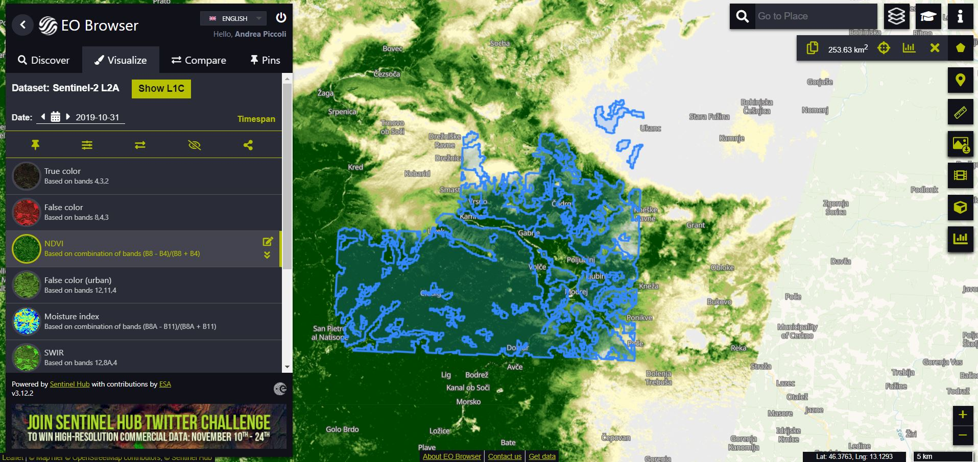
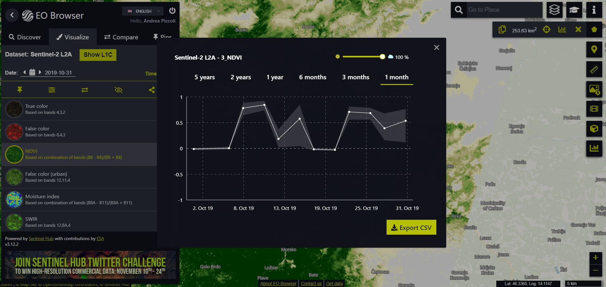
NDVI
NDVI values from the Sentinel 2 (L2A) dataset using the Sentinel Hub EO Browser
The two shapefiles were uploaded and the download for the mean NDVI value was achieved using the Statistical Info/Feature Info service chart
Maximum cloud cover value set to 10%
Years selected 2020-2016

Slide 19
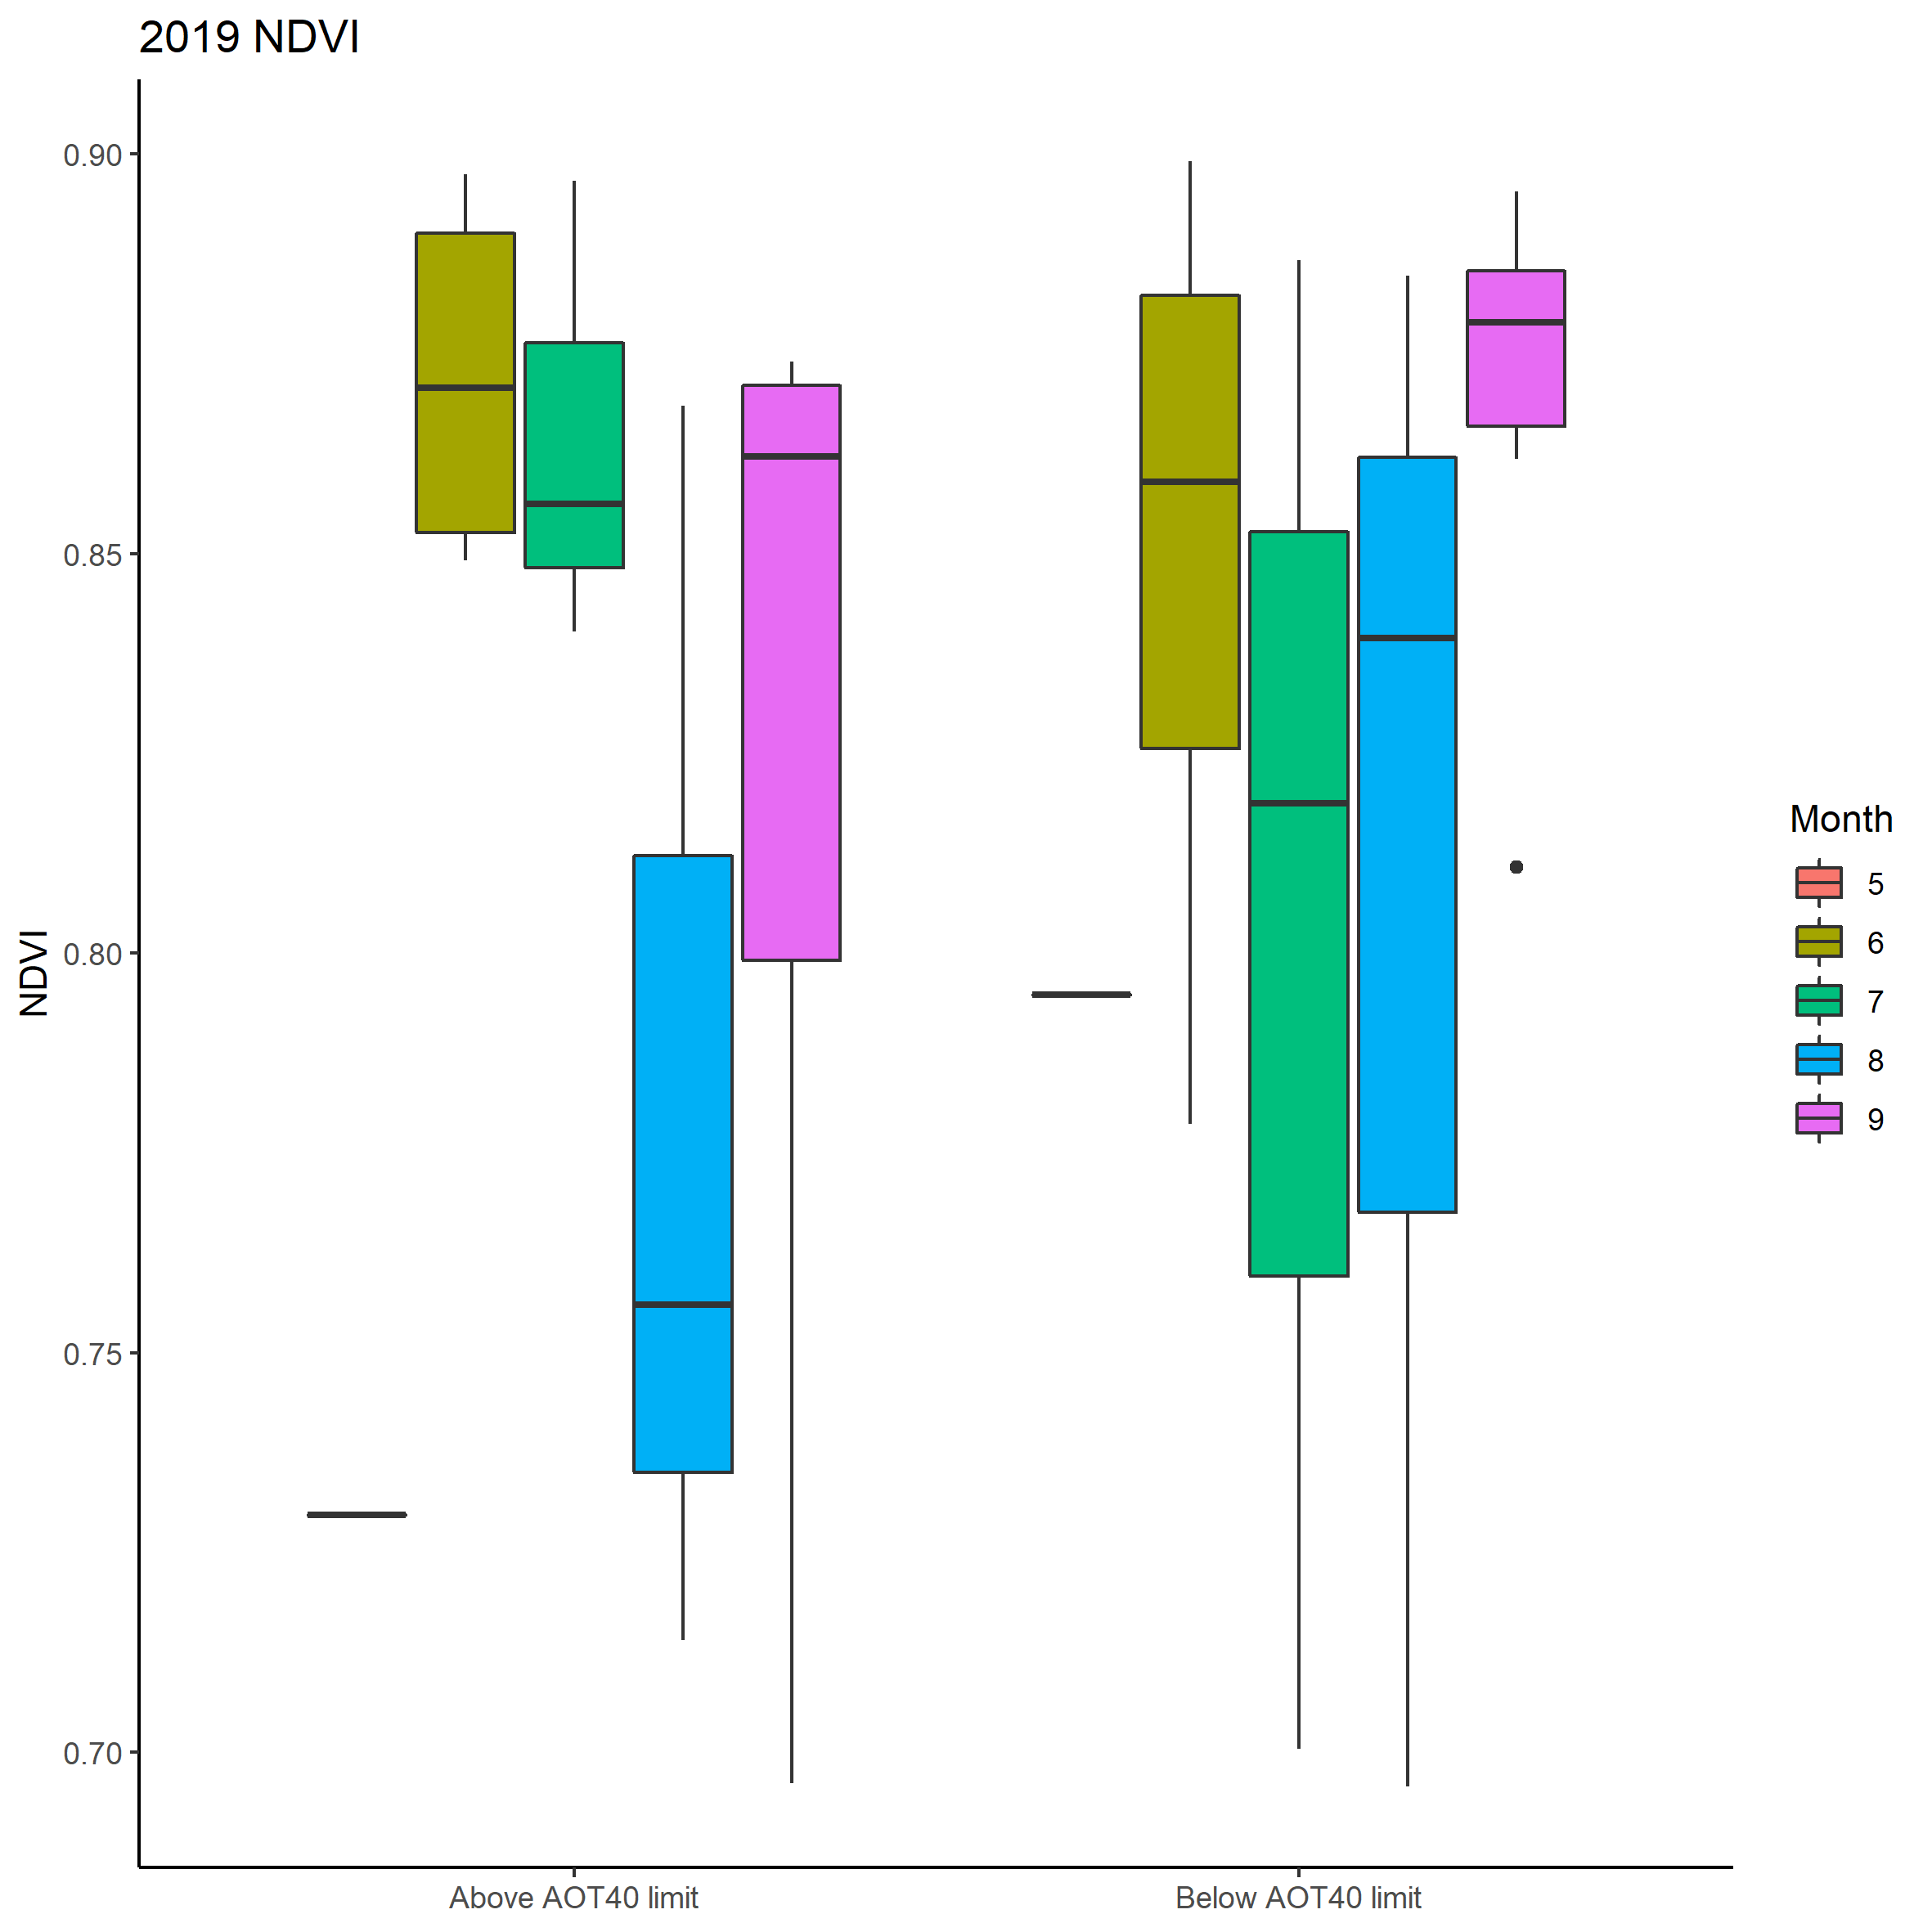
NDVI
Check if any significant difference is found between the two samples in growth season
2019 average NDVI: Above limit: 0.829 Below limit: 0.837
Kruskal-Wallis test p-value = 0.667
NO SIGNIFICANT DIFFERENCE BETWEEN SAMPLES!!

Slide 20
THANKS FOR THE ATTENTION

